Slide 1
基于层次的聚类
主要思想:
把数据对象排列成一个聚类树，在需要的层次上对其进行切割，相关联
的部分构成一个cluster。基于层次的聚类方法有两种类型：
（1）聚合层次聚类。最初每个对象是一个cluster，然后根据它们之间的相似性，对这些原子的cluster进行合并。大多数层次方法属于这一类，它们的主要区别是cluster之间的相似性的定义不同。
（2）划分层次聚类，它与上面的过程正好相反。

Slide 2
Step 0
Step 1
Step 2
Step 3
Step 4
agglomerative
(AGNES)
a
a b
b
a b c d e
c
c d e
d
d e
e
divisive
(DIANA)
Step 4
Step 3
Step 2
Step 1
Step 0

Slide 3
用户可以指定算法终止的条件，例如，聚类的个数或每个cluster的半径低于某个阀值。
弱点在于合并或分裂点的选取问题，因为一组对象一旦合并或分裂，就不能有undo的操作
时间复杂度为O（N²），对于处理大数据量有性能问题。

Slide 4
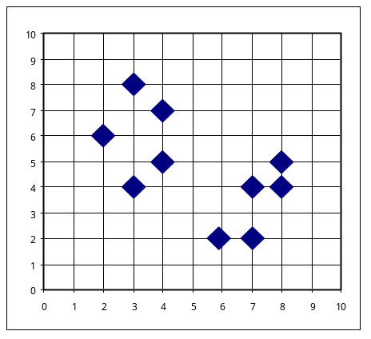
AGNES (Agglomerative Nesting)
Introduced in Kaufmann and Rousseeuw (1990)
Implemented in statistical analysis packages, e.g., Splus
Use the Single-Link method and the dissimilarity matrix.
Merge nodes that have the least dissimilarity
Go on in a non-descending fashion
Eventually all nodes belong to the same cluster

Slide 5
DIANA (Divisive Analysis)
Introduced in Kaufmann and Rousseeuw (1990)
Implemented in statistical analysis packages, e.g., Splus
Inverse order of AGNES
Eventually each node forms a cluster on its own

Slide 6

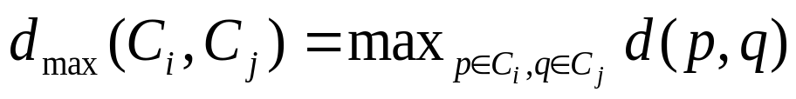
基于层次的聚类-族间距离
聚合层次聚类和划分层次聚类都是通过计算族间的距离来进行族的合并或者划分的。
设d(p，q)为两个数据对象p和q之间的距离，m_{i}和m_{j}分别为族C_{i}和C_{j}的中心，n_{i}和n_{j}分别代表族C_{i}和C_{j}中数据对象的个数，则族C_{i}和C_{j}之间的距离定义如下：
  最小距离：
  最大距离：

Slide 7
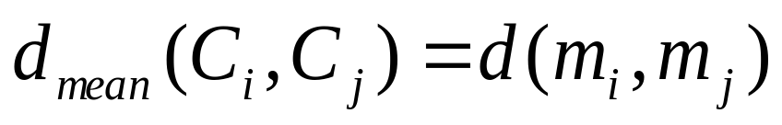
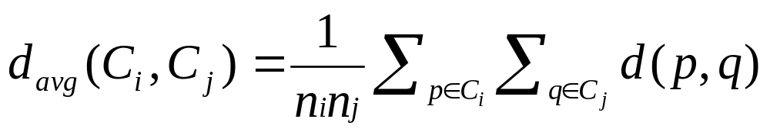
基于层次的聚类-族间距离
  中心点距离：
  平均距离：

Slide 8
基于层次的聚类-步骤
以聚合层次聚类为例，根据族之间的距离对相似的族进行逐步合并的过程如下：
[1] 每个数据对象自己构成一个原子族。
[2] 计算所有原子族之间的两两距离。
[3] 将距离最近的两个族进行合并，族的个数减1。
[4] 如果满足终止条件，则算法结束。否则计算新生成的族和其他族之间的距离并转步骤[3]。

Slide 9
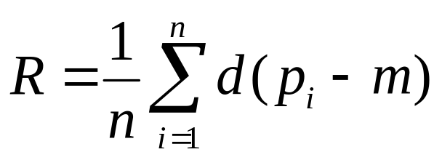
基于层次的聚类-步骤
算法终止的条件可以由用户指定。例如，可以指定当族的个数达到某个阈值或者每个族的半径低于某个阀值时算法停止。族的半径通常定义为：
其中，p_{i}为族中的每一个数据对象，m代表族的中心，n代表族中的数据对象个数。

Slide 10
基于层次的聚类
可以看出，聚合层次算法的核心是计算两个族之间的距离并将距离最近的两个族进行合并。
如果每一个族的内部都比较紧凑而且族和族之间分离地很好时，采用不同的距离定义所产生的聚类结果差别不大。
但是，如果族和族之间分离得不好（哪怕只是存在一些异常点），或者族的形状不是球形，或者族的大小不均匀时，根据不同的距离定义进行聚类的结果将差别很大。

Slide 11
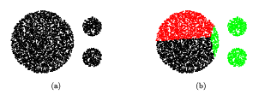
基于层次的聚类
例如，在如下（a）数据集上应用d_{max}，d_{avg}，d_{mean}距离定义时，将产生图（b）所示的族结构。

Slide 12
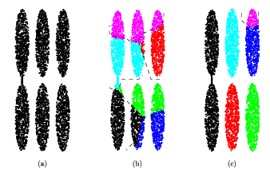
基于层次的聚类
类似地，在图（a）所示的数据集上应用d_{mean}距离定义时，将产生图（b）所示的族结构。其中的单个细长的族被切分，而属于邻近的多个细长族的不同部分又被合并。另一方面，当在图（a）所示的数据集上应用d_{min}距离定义时，将产生图（c）所示的族结构。两个细长族被连接了起来，产生了“链条”现象。

Slide 13
基于层次的聚类
可以看出，d_{mean}和d_{min}距离定义都不太适合非球形或大小不均匀的族结构。采用d_{mean}作为距离定义的缺点是它只取一个点（即族的中心点）作为整个族的代表点。对于一个特别大的族或者形状不规则的族，在进行聚合层次聚类时，它下一层的孩子族的中心点可能离得很远，无法合并成一个族，导致本该属于同一个族的点被分离到不同的族中。
与之相反，当采用d_{min}作为距离定义时，又走向了另一个极端，考虑了族中所有的点，即将族中的每一个点都作为代表点对待，该方法的缺点是容易受异常点的干扰，数据点位置的微小变化都可能导致聚类结构的变化。

Slide 14
Recent Hierarchical Clustering Methods
Major weakness of agglomerative clustering methods
  do not scale well: time complexity of at least O(n²), where n is the number of total objects
  can never undo what was done previously
Integration of hierarchical with distance-based clustering
  BIRCH (1996): uses CF-tree and incrementally adjusts the quality of sub-clusters
  CURE（1998）:Clustering Using Representatives
  ROCK (1999): clustering categorical data by neighbor and link analysis
  CHAMELEON (1999): hierarchical clustering using dynamic modeling

Slide 15
BIRCH (1996)
当数据量很大时，聚合层次聚类算法因为其非线性的时间复杂度和巨大的I/O开销可能会崩溃。为此人们提出了能够适用于大数据量聚类的BIRCH算法。
该方法首先针对数据集进行预聚类preclustering），在预聚类的过程中，将数据密集的区域压缩成微族（micro-cluster），构建一个初始的内存CF-Tree，其保留了数据的内在的聚类特征。
然后采用基于d_{mean}的聚合层次聚类方法对所有的微族进行聚类（相对于原始数据，这时的数据集已经很小了）。

Slide 16
BIRCH (1996)
Birch: Balanced Iterative Reducing and Clustering using Hierarchies (Zhang, Ramakrishnan & Livny, SIGMOD’96)
Incrementally construct a CF (Clustering Feature) tree, a hierarchical data structure for multiphase clustering
  Phase 1: scan DB to build an initial in-memory CF tree (a multi-level compression of the data that tries to preserve the inherent clustering structure of the data)
  Phase 2: use an arbitrary clustering algorithm to cluster the leaf nodes of the CF-tree
Scales linearly: finds a good clustering with a single scan and improves the quality with a few additional scans
Weakness: handles only numeric data, and sensitive to the order of the data record.

Slide 17



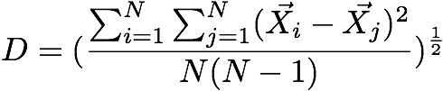
Similarity Metric(1)
Given a cluster of instances , we define:
Centroid:
Radius: average distance from member points to centroid
Diameter: average pair-wise distance within a cluster

Slide 18

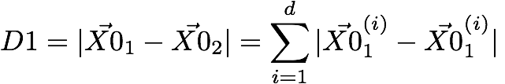

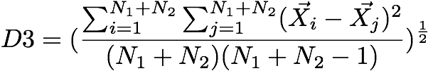
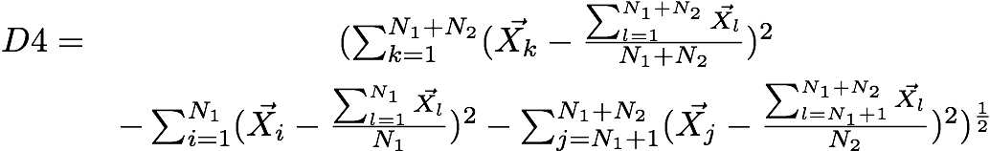
Similarity Metric(2)
centroid Euclidean distance:
centroid Manhattan distance:
average inter-cluster:
average intra-cluster:
variance increase:
D4 =

Slide 19
Clustering Feature
The Birch algorithm builds a dendrogram called clustering feature tree (CF tree) while scanning the data set.
Notes:
N is the number of data points
LS is the linear sum of the N points
SS is the square sum of the N points

Slide 20
Clustering Feature Vector in BIRCH
Clustering Feature: CF = (N, LS, SS)
N: Number of data points
LS: ∑^{N}_{i=1}X_{i}
SS: ∑^{N}_{i=1}X_{i}²
CF = (5, (16,30),(54,190))
(3,4)
(2,6)
(4,5)
(4,7)
(3,8)

Slide 21
CF-Tree in BIRCH
Clustering feature:
  summary of the statistics for a given subcluster: the 0-th, 1st and 2nd moments of the subcluster from the statistical point of view.
  registers crucial measurements for computing cluster and utilizes storage efficiently
A CF tree is a height-balanced tree that stores the clustering features for a hierarchical clustering
  A nonleaf node in a tree has descendants or “children”
  The nonleaf nodes store sums of the CFs of their children
A CF tree has two parameters
  Branching factor: specify the maximum number of children.
  threshold: max diameter of sub-clusters stored at the leaf nodes

Slide 22
Properties of Clustering Feature
CF entry is more compact
  Stores significantly less than all of the data points in the sub-cluster
A CF entry has sufficient information to calculate D0-D4
Additivity theorem allows us to merge sub-clusters incrementally & consistently
Notes:
CF Additivity Theorem: if CF_1 and CF_2 are disjoint, merging them is equal to the sum of their parts

Slide 23
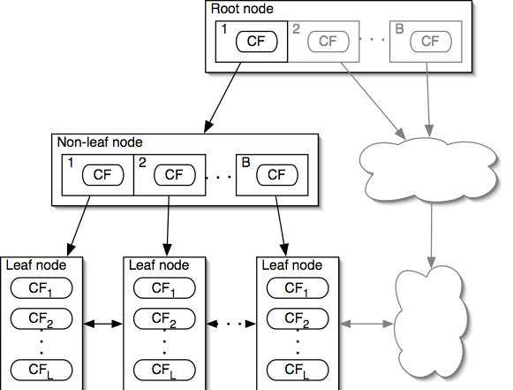
CF-Tree
Each non-leaf node has at most B entries
Each leaf node has at most L CF entries, each of which satisfies threshold T
Node size is determined by dimensionality of data space and input parameter P (page size)
Notes:
CF tree can be viewed as a multilevel compression of the data that tries to preserve the inherent clustering structure of the data
A non-leaf node entry is a CF triplet and a child node link
Each non-leaf node contains a number of child nodes. The number of children that a non-leaf node can contain is limited by a threshold called the branching factor.
A leaf node is a collection of CF triplets and links to the next and previous leaf nodes
Each leaf node contains a number of subclusters that contains a group of data instances
The diameter of a subcluster under a leaf node can not exceed a threshold.

Slide 24
CF-Tree Insertion
Recurse down from root, find the appropriate leaf
  Follow the "closest"-CF path, w.r.t. D0 / … / D4
Modify the leaf
  If the closest-CF leaf cannot absorb, make a new CF entry. If there is no room for new leaf, split the parent node
Traverse back
  Updating CFs on the path or splitting nodes
Notes:
Closest CF is determined by any of D0-D4
Leaf node split: take two farthest CFs and create two leaf nodes, put the remaining CFs (including the new one that caused the split) into the closest node.
Splitting the root on the traverse back increases tree height by one

Slide 25
CF-Tree Rebuilding
If we run out of space, increase threshold T
  By increasing the threshold, CFs absorb more data
Rebuilding "pushes" CFs over
  The larger T allows different CFs to group together
Reducibility theorem
  Increasing T will result in a CF-tree smaller than the original
  Rebuilding needs at most h extra pages of memory
Notes:
Bigger T = Smaller CF-tree
The rebuild will also take no more than h (height of the original tree) extra pages of memory (nodes)

Slide 26
Example of BIRCH
New subcluster
sc8
sc3
sc1
sc4
sc5
sc6
sc7
sc2
LN2
LN3
Root
LN1
LN1
LN2
LN3
sc8
sc1
sc3
sc4
sc5
sc6
sc7
sc2

Slide 27
Insertion Operation in BIRCH
If the branching factor of a leaf node can not exceed 3, then LN1 is split.
sc8
sc3
sc1
sc4
sc5
sc6
sc7
sc2
LN1’
LN2
LN3
LN1”
Root
LN1’
LN2
LN3
LN1”
sc8
sc1
sc3
sc4
sc5
sc6
sc7
sc2

Slide 28
If the branching factor of a non-leaf node can not
exceed 3, then the root is split and the height of
the CF Tree increases by one.
sc8
sc3
sc1
sc4
sc5
sc6
sc7
sc2
LN1’
LN2
LN3
LN1”
Root
NLN1
NLN2
LN1’
LN2
LN3
LN1”
sc8
sc1
sc2
sc3
sc4
sc5
sc6
sc7

Slide 29
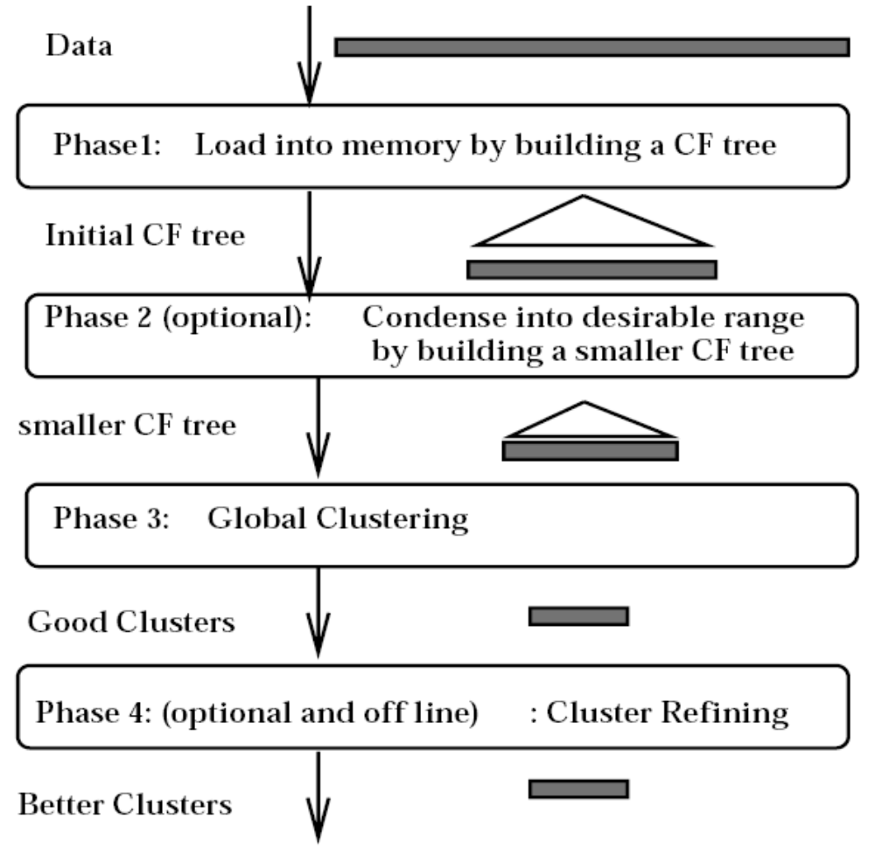
BIRCH Overview
Notes:
Phase 1: Load data into memory
Build an initial in-memory CF-tree with the data (one scan)
Subsequent phases become fast, accurate, less order sensitive
Phase 2: Condense data
Rebuild the CF-tree with a larger T
Condensing is optional
Phase 3: Global clustering
Use existing clustering algorithm on CF leafs
Phase 4: Cluster refining
Do additional passes over the dataset & reassign data points to the closest centroid from phase 3
Refining is optional

Slide 30
LinkClus: Efficient Clustering via Heterogeneous Semantic Links
Xiaoxin Yin, Jiawei Han
Univ. of Illinois at Urbana-Champaign
Philip S. Yu
IBM T.J. Watson Research Center

Slide 31
A Motivating Example
Authors
Proceedings
Conferences
Tom
sigmod03
sigmod04
sigmod
Mike
sigmod05
vldb03
Cathy
vldb04
vldb
John
vldb05
aaai04
aaai
Mary
aaai05
Questions:
Q1: How to cluster each type of objects?
Q2: How to define similarity between each type of objects?

Slide 32
Link-based Similarities
Two objects are similar if they are linked with similar objects
Jeh & Widom, 2002 - SimRank
The similarity between two objects x and y is defined as the average similarity between objects linked with x and those with y.
sigmod03
Tom
sigmod04
sigmod
Mary
sigmod05
Tom
sigmod03
sigmod04
sigmod
Very expensive to compute:
For a dataset of N objects and M links, it takes O(N²) space and O(M²) time to compute all similarities.
Mike
sigmod05
vldb03
Cathy
vldb04
vldb
John
vldb05
Notes:
In their paper Jeh and Widom give an efficient approach for approximating SimRank similarities, which only computes the similarity between two objects if they are linked with the same object. However, in this way the similarity between “sigmod” and “vldb” is never computed, neither is the similarity between “Mike” and “Cathy”, “sigmod03” and “vldb04”, etc. This will significantly affect the accuracy of clustering if no similarity is computed between those pairs of highly related objects.

Slide 33
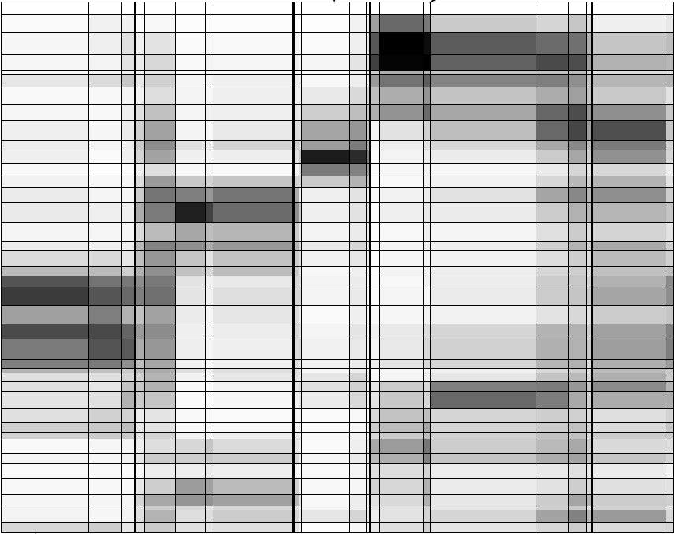
Observation 1: Hierarchical Structures
Hierarchical structures often exist naturally among objects (e.g., taxonomy of animals)
Relationships between articles and words (Chakrabarti, Papadimitriou, Modha, Faloutsos, 2004)
A hierarchical structure of products in Walmart
All
grocery
electronics
apparel
Articles
TV
DVD
camera
Words

Slide 34
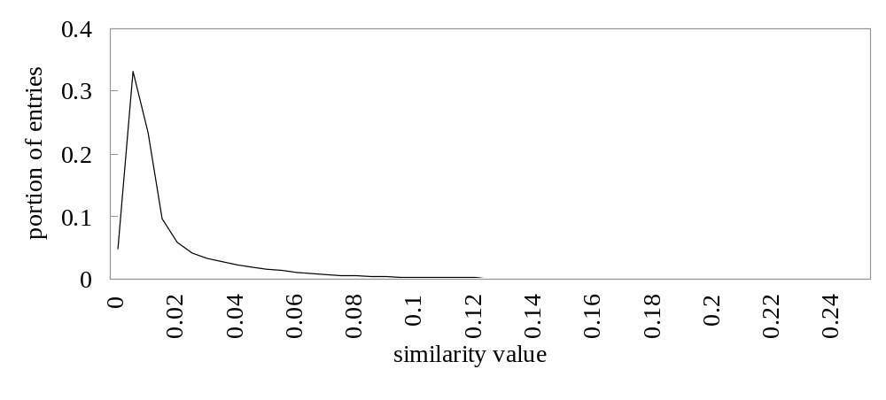
Observation 2: Distribution of Similarity
Distribution of SimRank similarities among DBLP authors
Power law distribution exists in similarities
  56% of similarity entries are in [0.005, 0.015]
  1.4% of similarity entries are larger than 0.1
  Our goal: Design a data structure that stores the significant similarities and compresses insignificant ones

Slide 35
Our Data Structure: SimTree
Each leaf node represents an object
Each non-leaf node represents a group of similar lower-level nodes
Similarities between siblings are stored
Canon A40 digital camera
Digital Cameras
Sony V3 digital camera
Consumer electronics
Apparels
TVs

Slide 36
Similarity Defined by A SimTree
Similarity between two sibling nodes n₁ and n₂
n₁
0.2
n₂
n₃
Adjustment ratio for node n₇
0.8
0.9
0.9
n₄
0.3
n₅
n₆
0.9
0.8
1.0
n₇
n₈
n₉
sim_{p}(n₇,n₈) =
  Path-based node similarity
Similarity between two nodes is the average similarity between objects linked with them in other SimTrees
Adjustment ratio for x =
s(n₇,n₄) x
s(n₄,n₅)
x s(n₅,n₈)
Average similarity between x and all other nodes
Average similarity between x’s parent and all other nodes

Slide 37
Overview of LinkClus
Initialize a SimTree for objects of each type
Repeat
  For each SimTree, update the similarities between its nodes using similarities in other SimTrees
    Similarity between two nodes x and y is the average similarity between objects linked with them
  Adjust the structure of each SimTree
    Assign each node to the parent node that it is most similar to

Slide 38
Initialization of SimTrees
The “SimTrees” before initialization
  Each leaf nodes have similarity 1 to itself and 0 to others
Initializing a SimTree
  Repeatedly find groups of tightly related nodes, which are merged into a higher-level node
10
11
12
13
14
15
16
17
18
19
20
21
22
23
24
ST₂
l
m
n
o
p
q
r
s
t
u
v
w
x
y
ST₁

Slide 39
(continued)
Tightness of a group of nodes
  For a group of nodes {n₁, …, n_{k}}, its tightness is defined as the number of leaf nodes in other SimTrees that are connected to all of {n₁, …, n_{k}}
Nodes
Leaf nodes in another SimTree
n₁
1
2
The tightness of {n₁, n₂} is 3
3
n₂
4
5
Notes:
We use this simple definition of tightness for efficiency concerns.

Slide 40
(continued)
Finding tight groups Frequent pattern mining
Procedure of initializing a tree
  Start from leaf nodes (level-0)
  At each level l, find non-overlapping groups of similar nodes with frequent pattern mining
Reduced to
Transactions
{n1}
n₁
1
The tightness of a group of nodes is the support of a frequent pattern
g₁
{n1, n2}
2
{n2}
n₂
3
{n1, n2}
4
{n1, n2}
5
{n2, n3, n4}
n₃
6
g₂
{n4}
7
{n3, n4}
n₄
8
{n3, n4}
9

